Slide 1

Unit 8: Cybersecurity and Global Impacts
Lesson 1: Project: Innovation Simulation Part 1
Lesson 2: Data Policies and Privacy
Lesson 3: The Value of Privacy
Lesson 4: Project: Innovation Simulation Part 2
Lesson 5: Security Risks Part 1
Lesson 6: Security Risks Part 2
Lesson 7: Project: Innovation Simulation Part 3
Lesson 8: Protecting Data Part 1
Lesson 9: Protecting Data Part 2
Lesson 10: Project: Innovation Simulation Part 4
Lesson 11: Assessment Day

Slide 2


Unit 8 - Lesson 1
Project: Innovation Simulation
Day 1
Computer Science Principles
Notes:
Lesson Plan: https://studio.code.org/s/csp8-2023/lessons/1

Slide 3


Slide 4


Day 1 - Warm Up
☁ Innovation Simulation ☁
Future School Convention

Slide 5




Day 1 - Warm Up
☁ Innovation Simulation ☁
Roles
Do This: Pass out badges, nameplates, and character bios.

Slide 6


Day 1 - Warm Up
☁ Innovation Simulation ☁
Simulation Mode
Ryanne
TEACHER
High School Physical Education

Slide 7
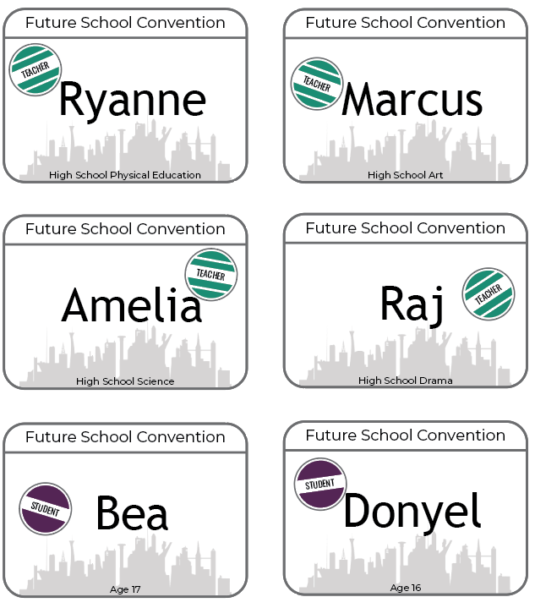
Day 1 - Warm Up
☁ Innovation Simulation ☁
Do This:
Read over your role sheet and introduce yourself to your group.
Remember to stay in character!

Slide 8
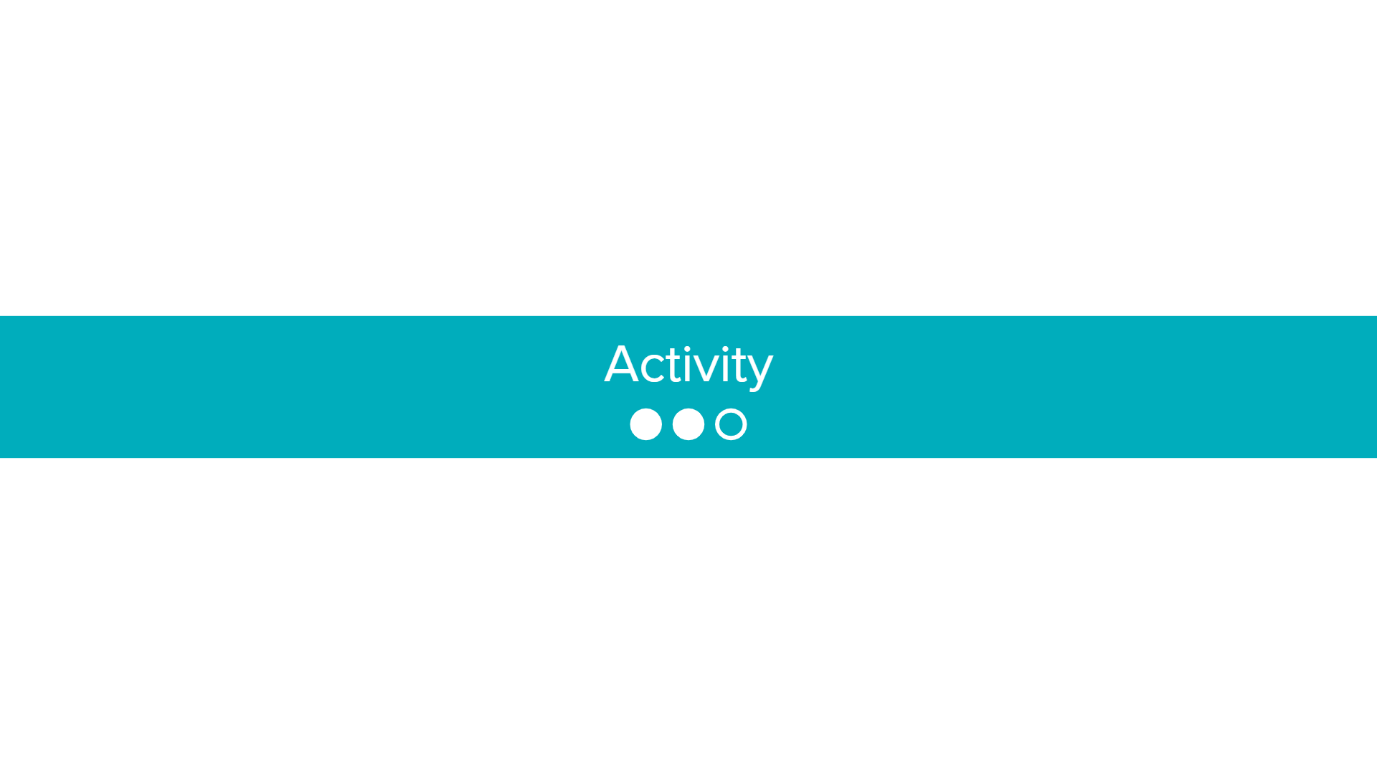

Slide 9

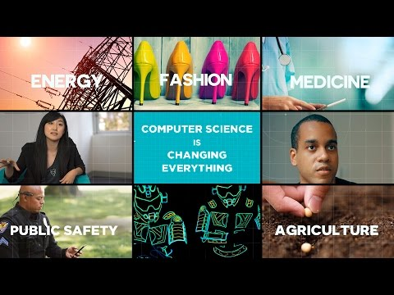
Day 1 - Activity
☁ Innovation Simulation ☁

Slide 10
Day 1 - Activity
☁ Innovation Simulation ☁
Step 1: Brainstorm
With your team, brainstorm computing innovations you believe would be beneficial to the Future School. Write your list on a piece of paper.
Consider: Is a program an important part of how the innovation works? If not, it might not be a computing innovation!

Slide 11
Day 1 - Activity
☁ Innovation Simulation ☁
Step 2: Reflect
In your Innovation Simulation Project Guide, use the given space to reflect on your specific wants and needs and what types of computing innovations would appeal to you.
Note: stay in your role!

Slide 12
Day 1 - Activity
☁ Innovation Simulation ☁
Step 3: Modeling Research
Let's find a computing innovation that is not related to school to use as an example.
On to Google!

Slide 13


Slide 14

Day 1 - Wrap Up
Notice the "Innovation Simulation" header is gone. That means it's time to return to your normal selves!
Do This:
Put away your badges and nameplates

Slide 15


Day 1 - Wrap Up
Create a Cluster!
Let’s add the following word into our AP CS Principles Unit Journal. Create a vocabulary page within your journal, or use our digital template.
Start with the word, your initial definition, and a visual representation of the word.
Computing Innovation
AP CSP
Unit Journal

Slide 16
Unit 8 Lesson 1 - Wrap Up
Prompt: What is the purpose of a computing innovation?
Computing Innovation: includes a program as an integral part of its function. Can be physical (e.g. self-driving car), non-physical computing software (e.g. picture editing software), or non-physical computing concepts (e.g., e-commerce).

Slide 17
Unit 8 - Lesson 1
Project: Innovation Simulation
Day 2
Computer Science Principles
Notes:
Lesson Plan: https://studio.code.org/s/csp8-2023/lessons/1

Slide 19
Day 2 - Warm Up
☁ Innovation Simulation ☁
Distribute:
Badges & Nameplates
Ryanne
TEACHER
High School Physical Education

Slide 20
Day 2 - Warm Up
☁ Innovation Simulation ☁
Prompt:
Why do you believe the Future School is in need of computing innovations?
What can computing innovations provide to a community?

Slide 22
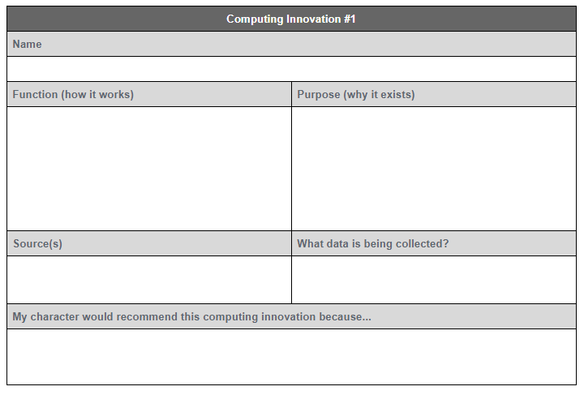
Day 2 - Activity
Research
Do This:
Research three different innovations that you (your character) believe would be beneficial to the Future School.
Fill out the Research section in the Project Guide.

Slide 24
Day 2 - Wrap Up
Prompt:
Which of your computing innovations would bring the most positive change to the school community?

Slide 25
Day 2 - Wrap Up
With your group and then the whole class discuss:
Common characteristics of these computing innovations that would bring the most positive change.

Slide 26
Unit 8 - Lesson 2
Data Policies and Privacy
Computer Science Principles
Notes:
Lesson Plan: https://studio.code.org/s/csp8-2023/lessons/2

Slide 28
Unit 8 Lesson 2 - Warm Up
Prompt: Which of the following pieces of information would you consider to be “private” or "personal", as in you wouldn't want it shared with just anyone.
Your full name
Your social security number
Your favorite musician / band
A picture of your face
Your fingerprint
Your birthdate
Your address
Where you go after school
Your phone number
Your medical history
Your racial / ethnic identity
A list of your best friends
A list of everything you've bought this month
A recording of your voice
Your IP address
A video of you singing a song
Your academic history / report card
The town or city you live in

Slide 30

Unit 8 Lesson 2 - Activity

Slide 31
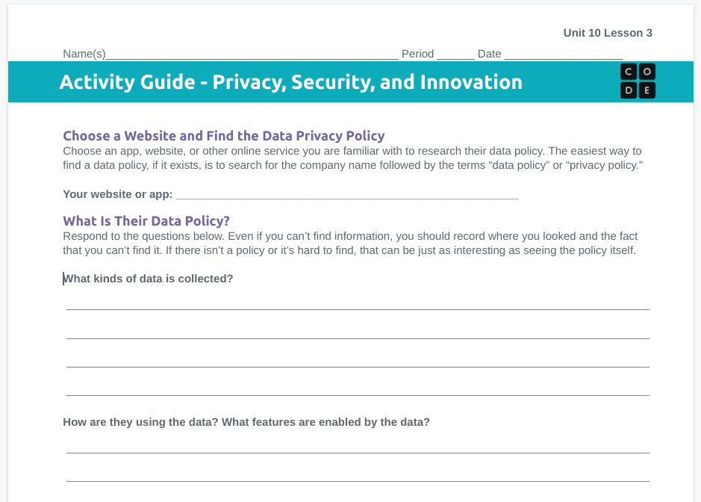
Unit 8 Lesson 2 - Activity
Pick a website or app of your own and complete the front page of the activity guide. We’ll do the back side next time.
Some apps / services to consider:
Education: Code.org, Khan Academy, Codecademy.com
Social media: Facebook, Twitter, Instagram, Snapchat, Tik Tok
Online store: Amazon, Target, Walmart
Search: Google, Bing
Maps: MapQuest, Yahoo Maps, Google Maps
Productivity: MS Office Online, Google Docs
Mail & communication: Gmail, Hotmail, Yahoo Mail, Skype, Google Hangouts
Streaming sites: Netflix, Spotify, Pandora
Gaming sites: Steam, Xbox Live
Banks and financial institutions: Chase, Citibank

Slide 33
Unit 8 Lesson 2 - Wrap Up
Create a Cluster!
Let’s add the following word into our AP CS Principles Unit Journal. Create a vocabulary page within your journal, or use our digital template.
Start with the word, your initial definition, and a visual representation of the word.
Personally Identifiable Information
AP CSP
Unit Journal

Slide 34
Unit 8 Lesson 2 - Wrap Up
Key Takeaways
Personally Identifiable Information (PII): information about an individual that identifies, links, relates, or describes them.
Technology enables the collection, use, and exploitation of information about, by and for individuals, groups, and institutions. Geolocation, cookies, and browsing history can all be used to create knowledge about an individual. Most digital technology needs some kind of PII to work (for example street navigation needs to know your location or PII stored online to simplify making online purchases).
Other times websites collect more data to improve their services.
Many services and websites collect information (like your browser history) that can be used to advertise to you by creating detailed profiles of who you are and what you like. Search engines also can record and maintain a history of searches made by users. This information can be used to suggest websites or for for targeted marketing.
Once data is made digital, and especially once it's shared online, it's much harder to control.
PII can be used to steal the identity of a person, or stalk them online. Information that is often posted on social media can be combined to create a profile on you.

Slide 35
Unit 8 - Lesson 3
The Value of Privacy
Computer Science Principles
Notes:
Lesson Plan: https://studio.code.org/s/csp8-2023/lessons/3

Slide 36
Unit 8 Lesson 3 - Warm Up
Prompt:
Review your activity guide from last class. Remind yourself what your privacy concerns were for the app / website you chose.

Slide 38
Unit 8 Lesson 3 - Activity
Prompt: As we watch the following video on facial recognition takes notes on:
What are the benefits of the technology? What does it make more convenient / fun?
What are the privacy concerns that arise?
Why would governments or businesses be interested in this technology?

Slide 39
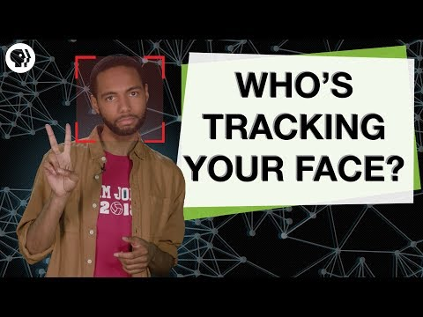
Unit 8 Lesson 3 - Activity

Slide 40
Unit 8 Lesson 3 - Activity
Share notes with a partner:
What are the benefits of the technology? What does it make more convenient / fun?
What are the privacy concerns that arise?
Why would governments or businesses be interested in this technology?
Discuss: Do you believe the privacy risks posed by facial recognition technology outweigh the benefits/convenience?

Slide 41
Unit 8 Lesson 3 - Activity
Prompt: As we watch the following video on location data, take notes on the following:
What kind of data is being collected and shared?
Who is the “third party” in this situation?
Why is this a tradeoff between privacy and security?

Slide 42

Unit 8 Lesson 3 - Activity

Slide 43
Unit 8 Lesson 3 - Activity
Share notes with a partner:
What kind of data is this question about?
Who is the “third party” in this situation? Why does it matter that a “third party” had the data?
Why is this a tradeoff between privacy and security?
Discuss: Do you agree with the Supreme Court’s ruling? Do you think it should apply to other kinds of data?

Slide 44
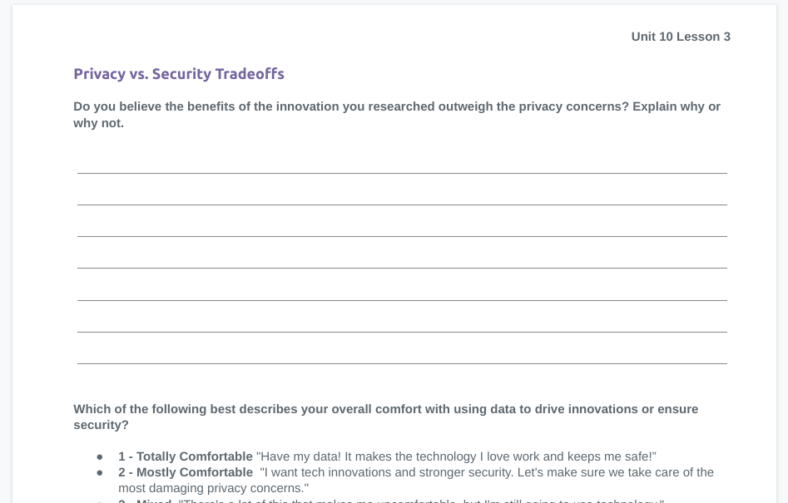
Unit 8 Lesson 3 - Activity
Individually fill out the last page on your activity guide
When you finish, discuss your responses with your partner. You don’t need to agree with one another.
If time allows, discuss with another group too.

Slide 46
Unit 8 Lesson 3 - Wrap Up
Hold up fingers for your response. Which of the following best describes your overall comfort with using data to drive innovations or ensure security.
1 - Totally Comfortable "Have my data! It makes the technology I love work and keeps me safe!”
2 - Mostly Comfortable
"I want tech innovations and stronger security. Let's make sure we take care of the most damaging privacy concerns."
3 - Mixed
"There's a lot of this that makes me uncomfortable, but I'm still going to use technology."
4 - Mostly Uncomfortable "Privacy is more important than empowering innovations or ensuring security. I would give up on some tech innovations to ensure my privacy"
5 - Totally Uncomfortable "I'd give up most technology and would like to see much stronger limits on what kind of data can be collected and stored, even if it limits the introduction of new technology and hinders government security"

Slide 47
Unit 8 Lesson 3 - Wrap Up
Key Takeaways
Our private data powers a lot of computing innovations in ways we like. It makes products that are convenient, interesting, personal, useful, and often “free” because we “pay” with our data.
Not every effect of a computing innovation is anticipated in advance.
This data can also be used by companies, governments, or criminals in ways that we didn’t intend or that threatens our privacy.
The balance between innovation, privacy, and security is continually being debated. You’re part of the next generation that will decide what kind of digital society we live in.
Legal and Ethical Concerns are raised by:
Computing innovations that harm people
Computing innovations that play a role in social and political issues
Examples:
software that allows access to digital media downloads and streaming
algorithms with bias
devices that collect and analyze data by continuously monitoring activities

Slide 48
Unit 8 - Lesson 4
Project: Innovation Simulation
Day 3
Computer Science Principles
Notes:
Lesson Plan: https://studio.code.org/s/csp8-2023/lessons/4

Slide 50
Day 3 - Warm Up
☁ Innovation Simulation ☁
Distribute:
Badges & Nameplates
Ryanne
TEACHER
High School Physical Education

Slide 51
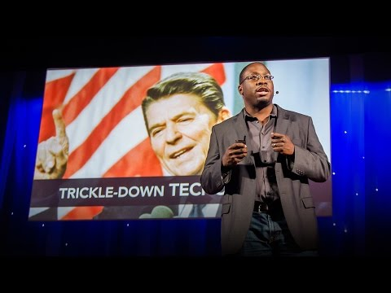
Day 3 - Warm Up
☁ Innovation Simulation ☁

Slide 52
Day 3 - Warm Up
☁ Innovation Simulation ☁
Computing innovations can have unintended consequences. Some of these unintended consequences are positive and some are negative.
While it is impossible to predict every outcome, by thinking critically and bringing multiple perspectives to the table we can try to better predict the ways our innovations may impact the world.

Slide 54
Day 3 - Activity
☁ Innovation Simulation ☁
Prompt
Remind yourself of your character’s goals and motivations.
What can your character’s perspectives and goals bring to the table? How can you help avoid some of the unintended consequences of your innovations?

Slide 55
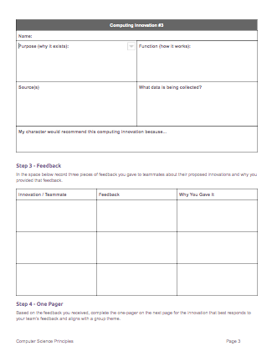
Day 3 - Activity
☁ Innovation Simulation ☁
Provide Feedback on Proposed Innovations
Review your teammates proposed innovations. Each of you should have at least three to share. Aim to:
Answer any questions about how the innovation works
Identify benefits / harms of the innovation from their character’s point of view. You likely won’t always agree!
Identify ways that different proposed innovations could work together to make an overall stronger proposal
Document your feedback in Step 3 of your Project Guide
Create a unifying theme for your presentation:
As a group, pick a unifying theme for your final presentation. Maybe you are focusing on student health or boosting test scores. Find the theme that makes the most sense given your innovations.
Each participant should narrow down their choices to one innovation that will be part of your team’s cohesive submission.

Slide 56
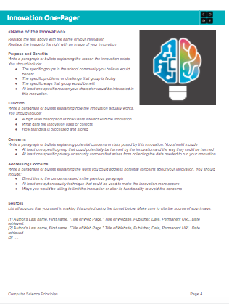
Day 3 - Activity
☁ Innovation Simulation ☁
Begin working on Innovation One-Pager
Based on the discussions you had with your team, pick the one innovation that you think has the potential to have the greatest positive effect on the schools for the largest number of people.
Begin working on filling in your Innovation One-pager, using your research as well as the feedback from your teammates.
You can find the directions for your One-pager in Step 4 of the Project Guide.

Slide 58
Unit 8 - Lesson 5
Security Risks Part 1
Computer Science Principles
Notes:
Lesson Plan: https://studio.code.org/s/csp8-2023/lessons/5

Slide 60
Unit 8 Lesson 5 - Warm Up
Prompt:
Have you ever received an email or a text message that looked suspicious? Have you ever been unsure if you should open the message or click on a link?
What are the things that made you suspicious?

Slide 62


Unit 8 Lesson 5 - Activity
Jigsaw:
With your jigsaw group, navigate to your assigned level on Code Studio.
Group 1: Keylogging (level 1)
Group 2: Phishing (level 2)
Group 3: Malware (level 3)
Look at the examples
Read the articles
Create a PSA (Public Service Announcement) slide.
What is the security risk?
How are people targeted?
What are the warnings?
Note: Visuals are encouraged! Don't write a paragraph on your slide. Each person in the group needs to make a slide on the topic.

Slide 63

Unit 8 Lesson 5 - Activity
Do This:
Form new groups, with one person from each topic area.
Show your slides to each other, and give an explanation of your security risk.
Make sure to cover:
What is the security risk?
How are people targeted?
What are the warnings?

Slide 64

Unit 8 Lesson 5 - Activity
Do This:
One volunteer from each topic area gives a one minute overview of their topic to the class.

Slide 66

Unit 8 Lesson 5 - Wrap Up
Create a Cluster!
Let’s add the following four words into our AP CS Principles Unit Journal. Create a vocabulary page within your journal, or use our digital template.
Start with the words, your initial definitions, and visual representations of the words.
Malware
Phishing
Rogue Access Point
Keylogging
AP CSP
Unit Journal

Slide 67
Unit 8 Lesson 5 - Wrap Up
Vocabulary:
Phishing: a technique that attempts to trick a user into providing personal information. That personal information can then be used to access sensitive online resources, such as bank accounts and emails.
Keylogging: the use of a program to record every keystroke made by a computer user in order to gain fraudulent access to passwords and other confidential information
Malware: software intended to damage a computing system or to take partial control over its operation
Rogue Access Point: a wireless access point that gives unauthorized access to secure networks.

Slide 68
Unit 8 - Lesson 6
Security Risks Part 2
Computer Science Principles
Notes:
Lesson Plan: https://studio.code.org/s/csp8-2023/lessons/6

Slide 70

Unit 8 Lesson 6 - Warm Up

Slide 72

Unit 8 Lesson 6 - Activity
Planet Money: Bad Credit Bureau
Episode 798, October 6, 2017
What is Equifax and what information are they storing?
(stop playing at 13:30)
Click to play audio

Slide 73
Unit 8 Lesson 6 - Activity
Equifax Data Breach: What Went Wrong
Breach Podcast - S2 Episode 3
What is Equifax and what information are they storing?
Start: 6:05
Stop: 11:13
Click to play audio

Slide 74
Unit 8 Lesson 6 - Activity
Prompt:
What information does Equifax store?
Why should I care?

Slide 75
Unit 8 Lesson 6 - Activity
Prompt:
As a computing innovation, what are the benefits of Equifax?
What are the potential harms?

Slide 76
Unit 8 Lesson 6 - Activity
Prompt:
What are the security risks?

Slide 77
Unit 8 Lesson 6 - Activity
Prompt:
What rules or regulations would you recommend be put in place to control how data is collected and shared?
What role (if any) should the government play?

Slide 79

Unit 8 Lesson 6 - Wrap Up
Let's Play

Slide 80
Unit 8 - Lesson 7
Project: Innovation Simulation
Day 4
Computer Science Principles
Notes:
Lesson Plan: https://studio.code.org/s/csp8-2023/lessons/7

Slide 82
Day 4 - Warm Up
☁ Innovation Simulation ☁
Distribute:
Badges & Nameplates
Ryanne
TEACHER
High School Physical Education

Slide 84
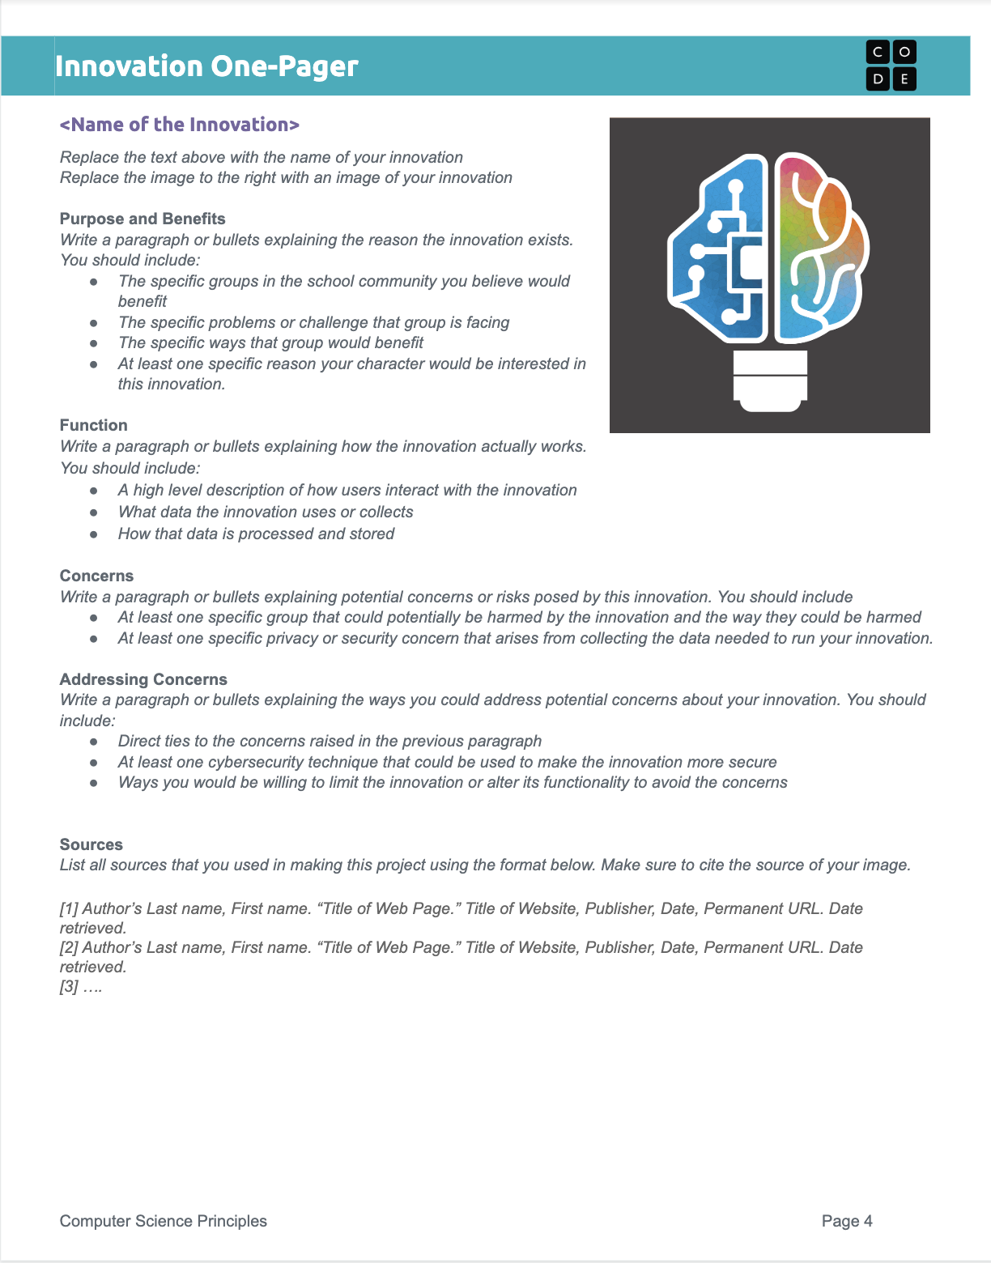
Day 4 - Activity
☁ Innovation Simulation ☁
Continue working on your one-pager

Slide 86



Day 4 - Wrap Up
Give One, Get One
Do This: Share your vocabulary cluster definitions and visualizations with your peers.
Give one of your ideas
Get one of your peer's ideas to build out one of your clusters
Find another classmate and repeat!
Vocabulary Cluster

Slide 87
Day 4 - Wrap Up
Prompt:
Explain how a computing innovation can have an impact beyond its intended purpose.
How can rapid sharing of a computing innovation affect these impacts?

Slide 88
Unit 8 - Lesson 8
Protecting Data Part 1
Computer Science Principles
Notes:
Lesson Plan: https://studio.code.org/s/csp8-2023/lessons/8

Slide 90
Unit 8 Lesson 8 - Warm Up
Do This: This message was encrypted using a Caesar Cipher (an "alphabetic shift"). Let's see how long it takes you to decode this message (remember it's just a shifting of the alphabet)
serr cvmmn va gur pnsrgrevn
free pizza in the cafeteria
Key: change every letter by 13
a b c d e f g h i j k l m n o p q r s t u v w x y z

Slide 92

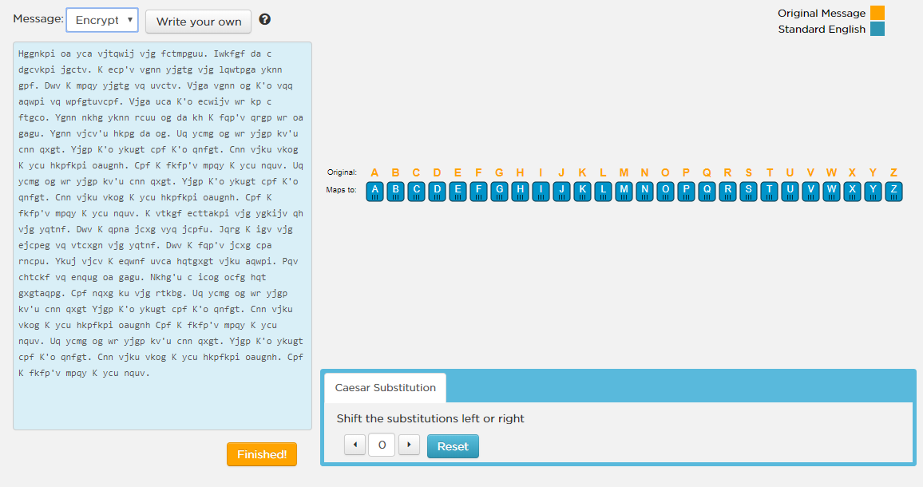
Unit 8 Lesson 8 - Activity
Caesar Cipher
Do This:
Navigate to Level 1
Experiment with the tool: click things, poke around, figure out what it's doing
Choose one of the messages from the drop-down menu and try to crack it using the tool.

Slide 93
Unit 8 Lesson 8 - Activity
Encryption Terms
Encryption: a process of encoding messages to keep them secret, so only "authorized" parties can read it.
Decryption: a process that reverses encryption, taking a secret message and reproducing the original plain text.
Cipher: the generic term for a technique (or algorithm) that performs encryption
Caesar's Cipher: a technique for encryption that shifts the alphabet by some number of characters.
Cracking encryption: When you attempt to decode a secret message without knowing all the specifics of the cipher, you are trying to crack the encryption.

Slide 94
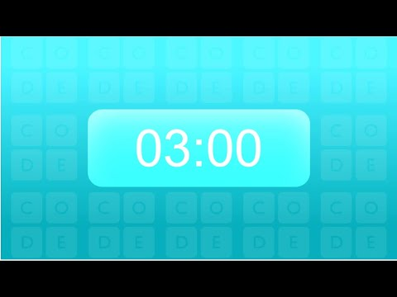
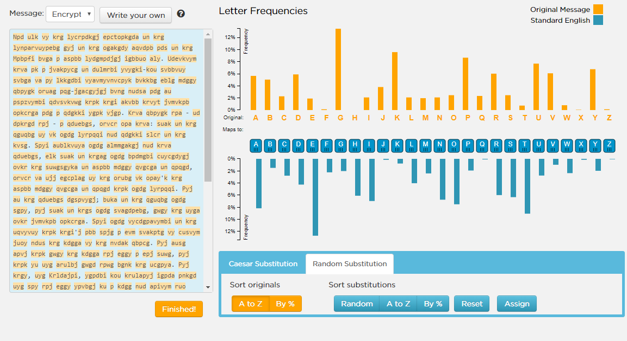
Unit 8 Lesson 8 - Activity
Random Substitution Cipher
Do This:
Navigate to Level 2
Experiment with the tool: click things, poke around, figure out what it's doing

Slide 95
Unit 8 Lesson 8 - Activity
Prompt:
How does the widget work? What steps would you take to crack the code?

Slide 96
Unit 8 Lesson 8 - Activity
Random Substitution Cipher
Do This: Crack a message using the tips we just talked about
Find the short words and "crack" them first. How many one-letter words do you know? ("a"). A very common 3-letter word is "the".
* Once you've done that, you have substitutes for some of the most common letters. You should be able to use intuition to look at other words with these partial substitutions and make good guesses.
* After finding only a handful of hard-fought letters, the rest will tumble quickly.
* Comparing the frequencies of letters gives good insight for making sensible guesses.

Slide 97
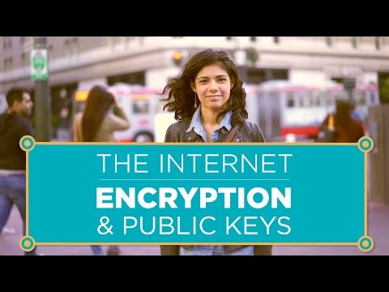
Unit 8 Lesson 8 - Activity

Slide 98
Unit 8 Lesson 8 - Activity
Prompt:
What is the difference between symmetric encryption and asymmetric (public key) encryption?

Slide 100
Unit 8 Lesson 8 - Wrap Up
Create a Cluster!
Let’s add the following four words into our AP CS Principles Unit Journal. Create a vocabulary page within your journal, or use our digital template.
Start with the words, your initial definitions, and visual representations of the words.
Encryption
Decryption
Symmetric Key Encryption
Public Key Encyption
AP CSP
Unit Journal

Slide 101
Unit 8 Lesson 8 - Wrap Up
Vocabulary:
Encryption: a process of encoding messages to keep them secret, so only "authorized" parties can read it.
Decryption: a process that reverses encryption, taking a secret message and reproducing the original plain text.
Symmetric Key Encryption: involves one key for both encryption and decryption.
Public Key Encryption: pairs a public key for encryption and a private key for decryption. The sender does not need the receiver’s private key to encrypt a message, but the receiver’s private key is required to decrypt the message.

Slide 102
Unit 8 - Lesson 9
Protecting Data Part 2
Computer Science Principles
Notes:
Lesson Plan: https://studio.code.org/s/csp8-2023/lessons/9

Slide 104
Unit 8 Lesson 9 - Warm Up
Prompt:
What strategies do you use when creating a good password?
Note: Don't actually reveal any of your current passwords in your discussion!

Slide 105
Unit 8 Lesson 9 - Warm Up
Takeaway:
A good password is easy to remember, but hard for someone else to guess based on knowledge they have about you

Slide 107
Unit 8 Lesson 9 - Activity
What can I do to protect my data?
Use Multifactor Authentication

Slide 108
Unit 8 Lesson 9 - Activity
Single Factor Authentication
Something you know
Example:
Password

Slide 109
Unit 8 Lesson 9 - Activity
Two Factor Authentication
Something you know
Something you possess
Example:
Password
Example:
Phone

Slide 110
Unit 8 Lesson 9 - Activity
Prompt:
What are the problems with this system? How could it be hacked?

Slide 111
Unit 8 Lesson 9 - Activity
Multifactor Authentication - at least two of these:
Something you know
Something you possess
Something you are
Example:
Password
Example:
Phone
Example:
Fingerprint

Slide 112
Unit 8 Lesson 9 - Activity
Prompt:
Why is this a better system than Single Factor Authentication? What are the challenges with this system?
Is it worth any of risks?

Slide 113
Unit 8 Lesson 9 - Activity
What can I do to protect my data?
Use Multifactor Authentication
Update Your Software

Slide 114

Unit 8 Lesson 9 - Activity
Quick Review:
What is a computer virus?

Slide 115
Unit 8 Lesson 9 - Activity
Prompt:
How can you protect your device from computer viruses?
Virus Scanning Software
Updating System Software

Slide 116

Unit 8 Lesson 9 - Activity
Data protection is a moving target!
It's important to keep your software up to date and use the best authentication practices you can.

Slide 117
Unit 8 Lesson 9 - Activity
Single-Select Questions with Reading Passage (SSQRP)
What's SSQRP?
Shows up on the AP CSP exam
Features a pretend computing innovation with a short explanation
Five multiple choice questions focusing on data, purpose and effect, benefits and harms, and security concerns.

Slide 118
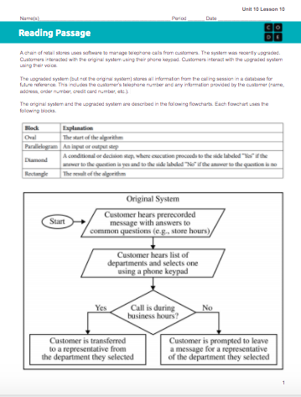
Unit 8 Lesson 9 - Activity
Do This:
Read the information about the Call Center in the SSQRP resource.

Slide 119
Unit 8 Lesson 9 - Activity
Single-Select Questions with Reading Passage (SSQRP) pull a total of 5 questions from each of these categories (computational thinking practices). The italics text represents text that may change depending on the computing innovation. The text highlighted in yellow represents the types of phrases you may see in these questions. The text in square brackets [ ] are different question options.
Sample Questions
Practice 3: Abstraction in Program Development | Practice 5: Computing Innovations
Which of the following input data [must be obtained/is needed] by the upgraded system that was NOT needed by the original system? | Which of the following is considered a potential effect of the the application rather than a [function/purpose] of the application?
Which of the following data is not [obtained/provided] directly from the user but is necessary for the upgraded system to operate as described? | Which of the following is [LEAST/MOST] likely to be a [BENEFIT/HARM] of storing the information from each calling session in a database?
Which of the following data is necessary for the Call Center to process in order to enable it to provide an answer to the caller? | Of the following potential benefits, which is [LEAST/MOST] likely to be provided by the upgraded system?
Which of the following is [LEAST/MOST] likely to be included in the directory? | Which of the following may be an unintended effect of the use of Call Center?
 | Which of the following is the [LEAST/MOST] [likely/plausible] data [PRIVACY/SECURITY/STORAGE] concern of the upgraded system?
 | Which of the following groups is [LEAST/MOST] likely to receive targeted advertisements?
 | Which of the following statements is [LEAST/MOST] likely to be true about the tradeoffs of the Call Center recording the caller's phone number?

Slide 120
Unit 8 Lesson 9 - Activity
Do This:
Go to AP Classroom, and complete the Call Center practice questions, as assigned by your teacher.
Then:
Discuss as a class.

Slide 122
Unit 8 Lesson 9 - Wrap Up
Prompt:
Discuss with a partner how you plan to protect your data.

Slide 123
Unit 8 Lesson 9 - Wrap Up
Create a Cluster!
Let’s add the following two words into our AP CS Principles Unit Journal. Create a vocabulary page within your journal, or use our digital template.
Start with the words, your initial definitions, and visual representations of the words.
Multi-factor Authentication
Computer Virus Scanning Software
AP CSP
Unit Journal

Slide 124
Unit 8 Lesson 9 - Wrap Up
Vocabulary:
Multifactor Authentication: a method of computer access in which a user has to successfully provide evidence in at least two of the following categories: knowledge (something they know), possession (something they have), and inherence (something they are). Each step provides a new layer of security.
Computer Virus Scanning Software: protects a computing system against infection.

Slide 125
Unit 8 - Lesson 10
Project: Innovation Simulation
Day 5
Computer Science Principles
Notes:
Lesson Plan: https://studio.code.org/s/csp8-2023/lessons/10

Slide 127
Day 5 - Warm Up
☁ Innovation Simulation ☁
Distribute:
Badges & Nameplates
Ryanne
TEACHER
High School Physical Education

Slide 129
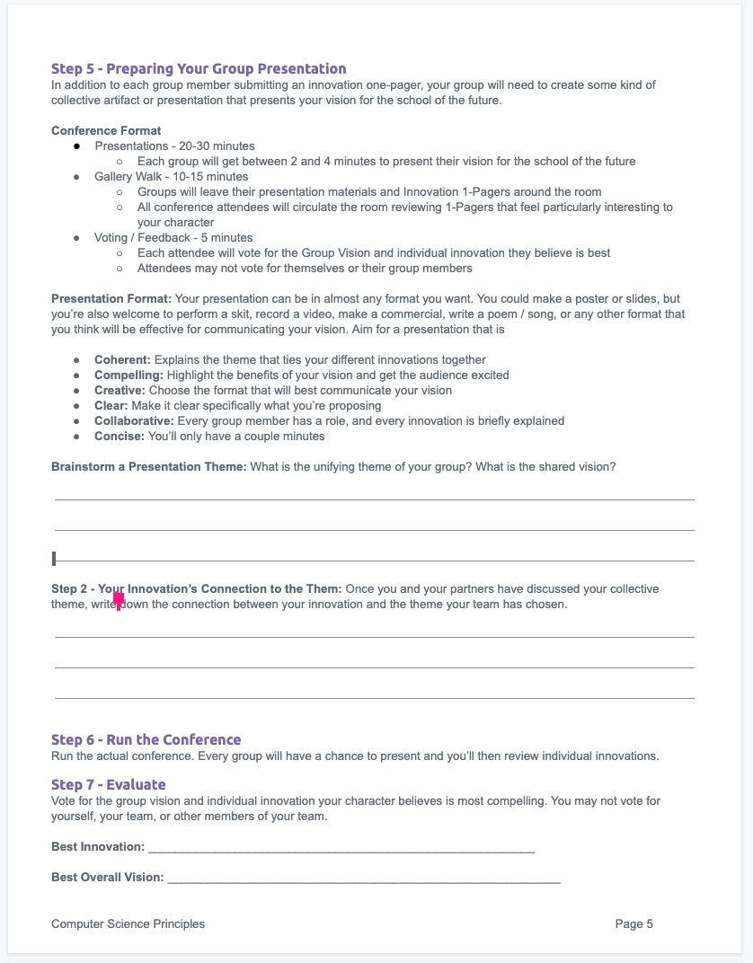
Day 5 - Activity
☁ Innovation Simulation ☁
First up: Finish the "Addressing Concerns" section in your One Pager. Then move on to Step 5 below.
Step 5 - Preparing Your Group Presentation
Review your group’s theme and vision and write it down.
Write down your innovation’s connection to the group or vision.
Begin developing slides, a poster, a skit, a song, a speech, or any other group format that will use in the presentation.

Slide 131
Day 5 - Wrap Up
Give One, Get One
Do This: Share your vocabulary cluster definitions and visualizations with your peers.
Give one of your ideas
Get one of your peer's ideas to build out one of your clusters
Find another classmate and repeat!
Vocabulary Cluster

Slide 132
Unit 8 - Lesson 10
Project: Innovation Simulation
Day 6
Computer Science Principles

Slide 134
Day 6 - Warm Up
☁ Innovation Simulation ☁
Distribute:
Badges & Nameplates
Ryanne
TEACHER
High School Physical Education

Slide 136
Day 6 - Activity
☁ Innovation Simulation ☁
Feedback - 10 mins
Break your team into smaller groups of 2 - 3
Find another small group from another team
Spend 3-5 minutes each sharing your innovations, theme, and ideas for the presentation
Give constructive feedback on their ideas, keeping in mind you character’s perspective

Slide 137
Day 6 - Activity
☁ Innovation Simulation ☁
Work Time
Finish your group presentation
Make any final edits to your one-pager

Slide 139
Day 6 - Wrap Up
☁ Innovation Simulation ☁
Next time we meet make sure:
You’re ready for the group presentation
Your one-pager is ready to share

Slide 140
Unit 8 - Lesson 10
Project: Innovation Simulation
Day 7
Computer Science Principles

Slide 142
Day 7 - Warm Up
☁ Innovation Simulation ☁
Distribute:
Badges & Nameplates
Ryanne
TEACHER
High School Physical Education

Slide 144
Day 7 - Activity
☁ Innovation Simulation ☁
Presentations!
Each group gets 2 - 4 minutes
Take notes on groups and innovations you want to review during the Gallery Walk

Slide 145
Day 7 - Activity
☁ Innovation Simulation ☁
Gallery Walk
Review one-pagers for the specific innovations you marked in your notes, plus any others you have time for
Be ready to vote on an innovation and overall project you believe is best. Consider:
Meeting your character’s needs
Overall cohesion of group project
Clarity on how the innovation(s) work
Thoughtful approach to balancing benefits, harms, risks, and ways to address them

Slide 147
Day 7 - Wrap Up
☁ Innovation Simulation ☁
Vote and Submit!
Fill in Part 7 by voting for the best project and innovation
Submit your project guide, one-pager, and any materials related to your presentation

Slide 148
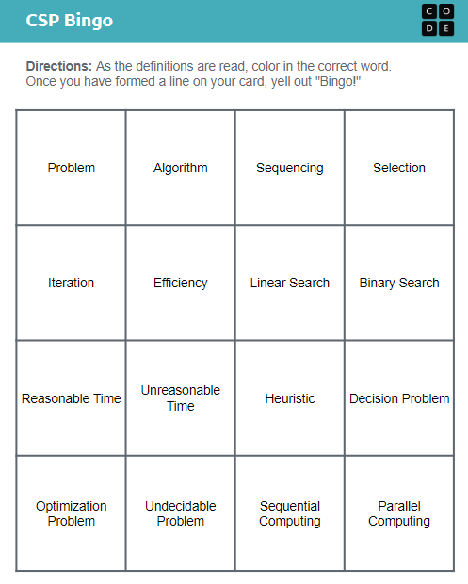

CSP Bingo!
Day 7 - Wrap Up
Unit 1 Lesson 8 - Warm Up
You should have:
a CSP Bingo card
pen / pencil / marker

Slide 149
CSP Bingo!
Day 7 - Wrap Up
Unit 1 Lesson 8 - Warm Up
Do This: As the definitions are read, color in the correct word on your CSP Bingo card.
Once you have formed a line on your card, yell out "Bingo!"

Slide 150
Unit 8 - Lesson 11
Assessment Day

Slide 152
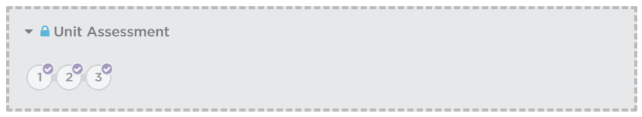
Unit 8 Lesson 11 - Activity
Unit Assessment

